Slide 1
第二十五章 汽车车身
Chapter 25: Car Body

Slide 2
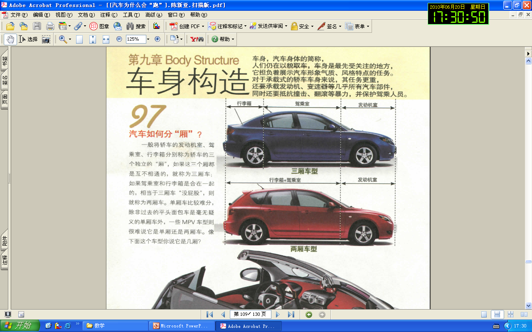
概述Overview

Slide 3
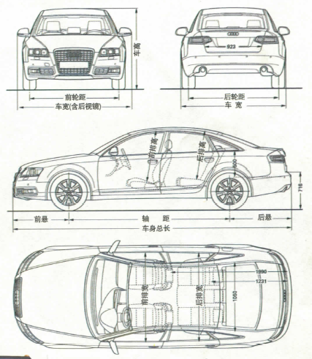
车身的定义及对一般要求
Definition and requirements of frame
汽车车身:驾驶员的工作场所,也是容纳乘客和货物的场所（除发动机和底盘之外的汽车结构）。Body is where a driver works and where accommodates passengers and cargos. (It is a part of vehicle besides engine and chassis) .
乘坐舒适性和运输货物完整性、操作方便性和被动安全性要求。It should meet the needs of ride comfort, operation convenience and passive safety. It should keep the completeness of cargos.
空气动力性、行驶稳定性及良好的热环境要求。It should have high aerodynamic performance, high riding stability and good thermal environment.
内、外造型、装饰、色彩的艺术性要求。Meet the artistic needs of inside and outside automobile design, decoration and color.

Slide 4
车身的主要功用
Main functions of body
为驾驶员提供良好的操作条件和舒适的工作场所；It should provide drivers with good operating condition and comfort working environment;
隔离汽车行驶时的振动、噪音、废气以及恶劣气候的影响，为乘员提供舒适的乘坐条件；It should isolate vibration, noise, waste gas and harsh climate and provide passengers with comfort riding environment;
保证完好无损地运载货物且装卸方便；It should keep the completeness of cargo and make them easy to load and unload;
车身结构和设备可以保证行车安全和减轻事故后果；The structure of body and its equipment should ensure the safety of driving and reduce the influence of an incident.
车身合理的外部形状，可以在汽车行驶时有效引导周围的气流，提高汽车的动力性、燃料经济性和行驶稳定性，改善发动机的冷却条件和驾驶室内的通风。The reasonable outer shape of body can effectively steer the surrounding current and should improve the dynamic characteristics, fuel economy and driving stability. It should also improve the cooling condition of engine and ventilation inside the cab.

Slide 5
相关名词术语
Related Terminology
车身结构包括：车身壳体、车前板制件、车门、车窗、车身外部装饰件和内部覆饰件、座椅以及通风、暖气、空调装置等。在货车和专用汽车上还包括货箱和其他装备。The structure of body includes body shell, front sheet metal, doors, windows, exterior automotive decorative trim, interior trimming parts, seats, ventilator, heater, air-conditioning system and so on. There should also be cargo body and other equipment on truck and special purpose vehicle.
轿车车身：轿车车身一般有车身本体（白车身）、外装饰、内装饰以及车身电器附件组成。Car body includes BIW(body in white), exterior trim, interior trim and electric accessories.
车身本体（白车身） ：一切焊接和装配完成的、有待涂装的白皮车身。包括车身焊接总成、开闭件、翼子板等。BIW(body in white): all kinds of white body that are welded and assembled and ready to do coating. It include body welded assembly, closure, fender and so on.
车身壳体(白车身焊接总成)：包括地板、顶盖、前围板、后围板，侧围等分总成。Body welded assembly includes floor, bonnet, front bulkhead, rear bulkhead, side wall and so on.

Slide 6
相关名词术语
Related Terminology
车身外饰件：车身外部起保护、装饰作用的部件和实现某种功能的附件。包括前和后保险杠、装饰和密封条、车外后视镜、散热器面罩、天窗及其附件、扰流板等。Exterior automotive decorative trim is an accessory that protects the body, decorates the body and achieves certain function. It includes front and rear bumper, decoration, seal strip, rear view mirror, radiator grill, sun roof, spoiler plate and so on.
车身内饰件：车身内部对人体起保护、装饰作用的部件和实现某种功能的附件。包括仪表板、座椅及安全带、安全气囊、遮阳板、车内后视镜、车门和地板内饰等。Interior trimming parts are accessories that protect human, decorate the body and achieve certain function. It includes dashboard, seat, seat belt, bumping bag, sun visor, rear view mirror, door, floor decoration and so on.
车身电器附件：除用于发动机和底盘以外的所有电器和电子装置。包括各种仪表及开关、照明及信号、音响、空调、雨刮和洗涤器、除霜、防盗、GPS等装置和系统。Electric accessories are all electric and electronic devices except those for engine and chassis. It includes gauge, switch, illumination, CAS(Car audio system), air conditioner, wiper, washer, defrost, theft deterrent and GPS system.

Slide 7
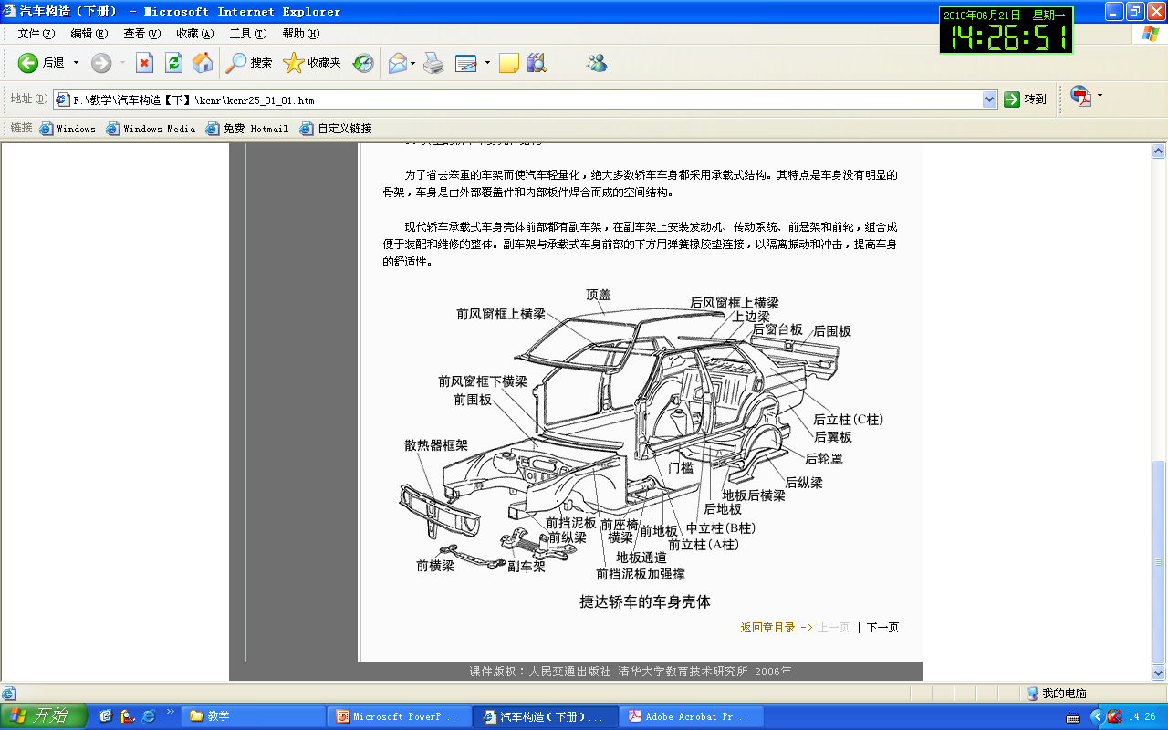
第一节 车身壳体、车前板制件及车门、车窗
Section 1: Body shell, front sheet metal, door, and window

Slide 8
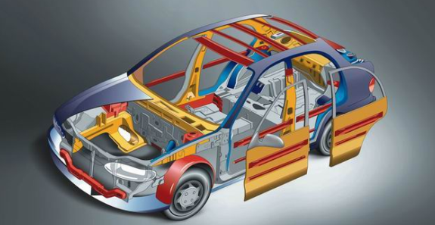
车身壳体Body shell
车身壳体通常是指纵、横梁和立柱等主要承力元件以及连接它们的板件共同组成的刚性结构空间。Body shell is a rigid structural space formed by load-bearing units as longerons, cross beams, pillars and plates connecting them.
客车车身多数具有明显的骨架，而轿车车身和货车驾驶室则没有明显的骨架。Most bus bodies have obvious frames, but sedan bodies and cabs of trucks have no obvious frames.

Slide 9
对车身壳体的要求
Requirements for body shell
车身壳体要有充分合理的强度、静及动刚度、被动安全性。Body shell must have sufficient and reasonable strength, static and dynamic stiffness and passive safety.
刚度不足，会引起车身的门框、动力总成等安装部位的相对变形，导致相关安装总成不能正常工作。Insufficient stiffness will cause relative deformation of mounting parts such as door frame and power train. Also, it will make relative assembly fail to work properly.
不合理的动刚度，会导致车身共振和噪声，降低车身结构疲劳寿命。Unreasonable active stiffness will lead to resonance and noise which will shorten the fatigue life of body structure.
车身被动安全性是满足或超过相关法规要求的主要保障。Passive safety is the main guarantee that meets or surpasses the requirements of relative laws and regulations.

Slide 10
车身壳体分类
Classification of body shell
车身壳体按受力特征可分为承载式、非承载式和半承载式三种。Classification of body shell can be sorted as monocoque, composite and semi-integral body.
承载式特点是汽车没有车架，车身就作为发动机和底盘各总成的安装基体，车身兼有车架的作用并承受全部载荷。Monocoque body has no frame. The body itself is the basal body to install engine and chassis. the body functions as frame and all the forces is supported by the body.
非承载式特点是车身通过橡胶软垫或弹簧与车架作柔性连接。车架是支承全车的基础，承受着在其上所安装的各个总成的各种载荷。车身只承受所装载的人员和货物的重量及惯性力，在车架设计时不考虑车身对车架承载所起的辅助作用。Composite body is connected to frame through flexible connection by rubber cushion or spring. Frame is the basic part to support the whole car and bears all loads of all assemblies mounted on it. The body only bears the weight of passengers and cargos and inertia force. When we design the frame, we don’t take the supplementary role of body that helps frame bear weight into consideration.
半承载式特点是车身通过焊接、铆接或螺钉与车架刚性连接，车架是承受各个总成载荷的主要构件，车身在一定程度上有助于加固车架，分担车架所承受的一部分载荷。 semi-integral body is connected to frame through rigid connection such as welding, riveting or screwing. Frame is the main part to bear all loads of assemblies. The body to some extent helps firm the frame and bears part of loads.

Slide 11
典型轿车车身壳体结构
Typical shell structure of sedan body
绝大多数轿车车身都采用承载式结构。其特点是车身没有明显的骨架，车身是由外部覆盖件和内部板件焊合而成的空间结构。Most sedan bodies are monocoque ones. Monocoque body has no obvious frame. The body is a space structure welded by exterior trims and interior plates.
现代轿车承载式车身壳体前部都有副车架，在副车架上安装发动机、传动系统、前悬架和前轮，组合成便于装配和维修的整体。Body shell of monocoque body of modern sedan has a auxiliary frame in front of it. Engine, drive train, front suspension and front wheels are mounted on the auxiliary frame to form a integrated unit, so that it is easy to assemble and repair.
副车架与承载式车身前部的下方用弹簧橡胶垫连接，以隔离振动和冲击，提高舒适性。Auxiliary frame is connected to the bottom of the front part of monocoque body by spring and rubber mat in order to isolate vibration and impact and thus improve riding comfort.

Slide 12
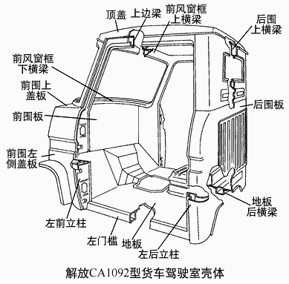
典型驾驶室壳体结构
Typical shell structure of a cab
绝大多数货车驾驶室都是非承载式的结构，驾驶室没有明显的骨架，由外部覆盖件和内部板件焊合成壳体，通过3点或4点弹性悬置与车架连接。 Most cabs of trucks are body-chassis construction and have no obvious frames. the shell welded by exterior trims and interior plates is flexibly suspended to the frame through 3 or 4 points.

Slide 13
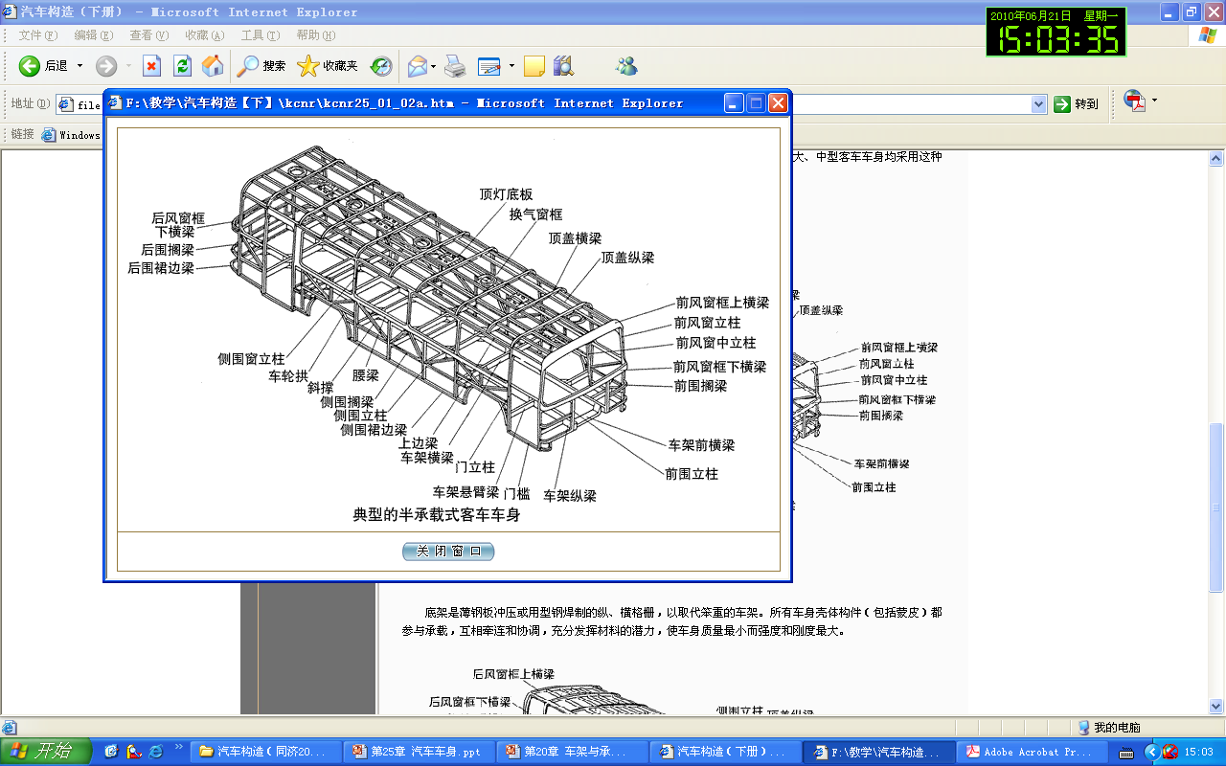
典型客车车身壳体结构
Typical shell structure of bus body
特点是在客车专用底盘上将车架用若干悬臂梁加宽并与车身侧壁刚性连接，使车身骨架也分担车架的一部分载荷，其中车架由两根前后直通的纵梁与若干横梁等组成。许多国产大、中型客车车身均采用这种结构形式。Its feature is that the frame is widened by a certain number of cantilever beam and is connected to body side panel through rigid connection on a dedicated bus chassis, in order that the body skeleton also bears some loads for the frame. The frame is formed by two longerons though the whole vehicle and a certain number of crossbeams. This structural form is taken by many large or middle scale bus bodies in China.
典型半承载式客车车身
Typical semi-integral bus body

Slide 14
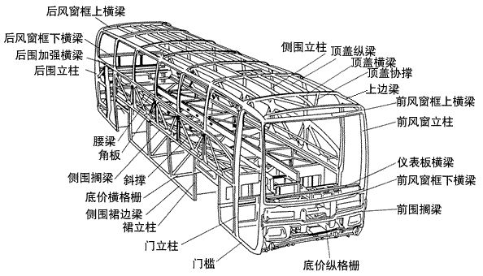
典型客车车身壳体结构
Typical shell structure of bus body
底架是薄钢板冲压或用型钢焊制的纵、横格栅，以取代笨重的车架。所有车身壳体构件（包括蒙皮）都参与承载，互相牵连和协调，充分发挥材料的潜力，使车身质量最小而强度和刚度最大。 The body understructure is a grid stamped by sheet steel or welded by formed steel to replace hulking frame. All structural components of body shell (including outer panel skin) bear the load, interrelate and coordinate with each other and make full use of the potential of material. This will make the car to lightest and at the same time strongest and most stiff.
典型承载式客车车身
Typical monocoque bus body

Slide 15
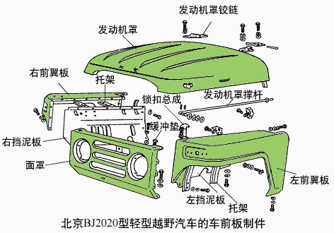
车前板制件Front sheet metal
长头式汽车车身都有若干车前板制件，相互焊接或安装，形成容纳发动机和前轮的空间。A cab-behind-engine bus has several front sheet metals. It is welded or mounted together to form a space for engine and front wheels.

Slide 16
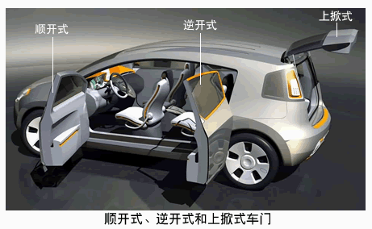
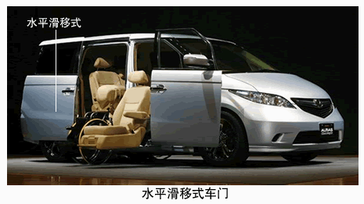
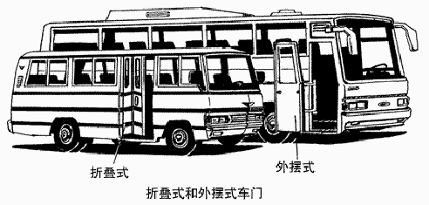
车门及其附件Door and its accessories
按其开启方式可分为：顺开式、逆开式、水平滑移式、上掀式、折叠式和外摆式等。According the opening way we divide it into forward open type, backward open type, horizontal slippage type, flip-up type, folding type, swing out type and so on.

Slide 17
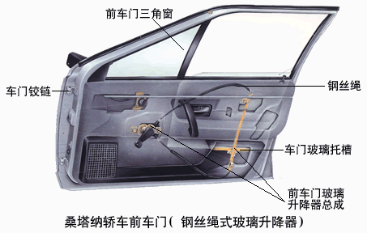
车门及其附件Door and its accessorie

Slide 18
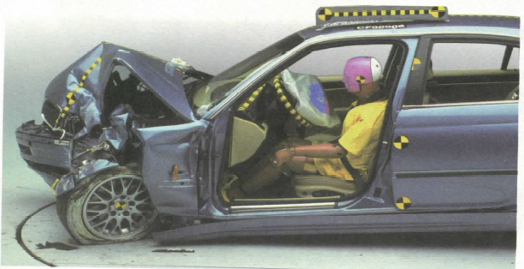
第二节 车身附属装置及安全防护装置
Section 2: Body accessories and safety devices

Slide 19
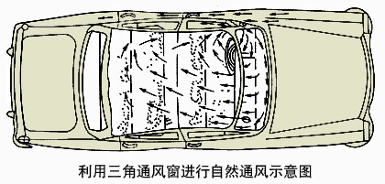
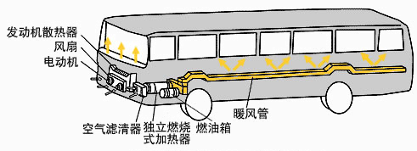
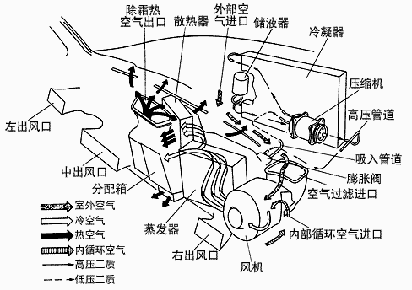
车身附属装置
Body accessories
独立燃烧式通风与暖气联合装置
independent fuel fired type heating & ventilating device
通风装置ventilating device
四季空调系统Air-conditioner

Slide 20
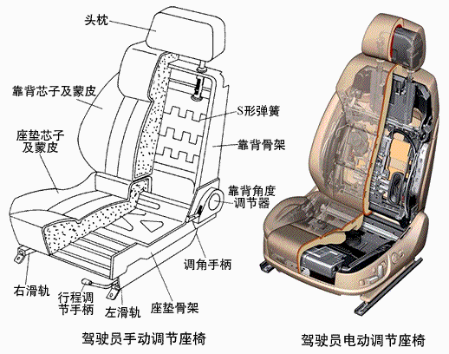
汽车座椅Seat
座椅由骨架、座垫、靠背、头枕和调节机构等部分组成。A seat is formed by bare frame, cushion, backrest, headrest and adjuster and so on.

Slide 21
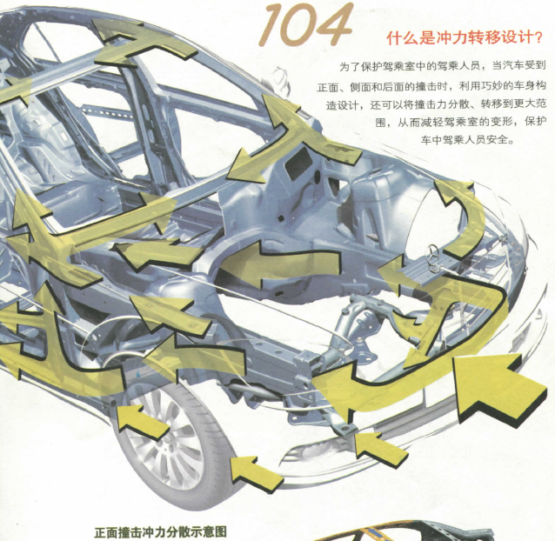
安全防护装置
Safety devices

Slide 22
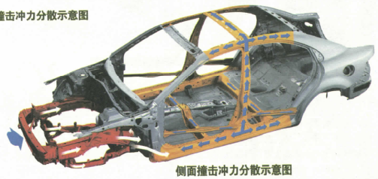
安全防护装置
Safety devices

Slide 23
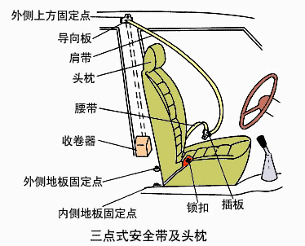
安全防护装置
Safety devices

Slide 24
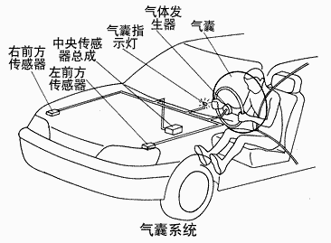
安全防护装置
Safety devices
其它安全防护装置还包括保险杠、发动机罩、头枕、仪表板、转向盘、座椅等。Other safety devices include bumper, engine cowl, headrest, gauge panel, seat, steering wheel and so on.

Slide 25
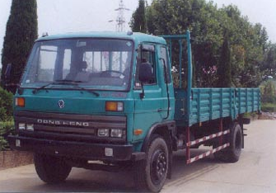
第三节 货箱
Section 3: cargo body

Slide 26
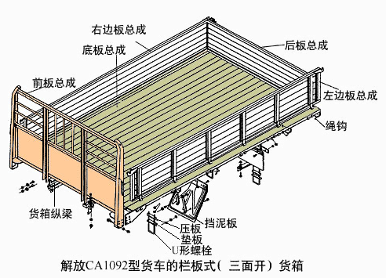
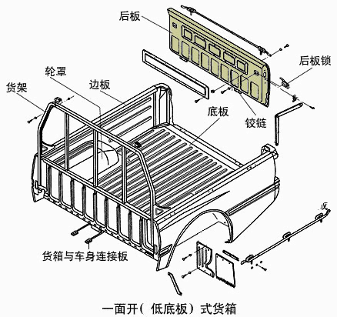
栏板式货箱
Rack-body

Slide 27
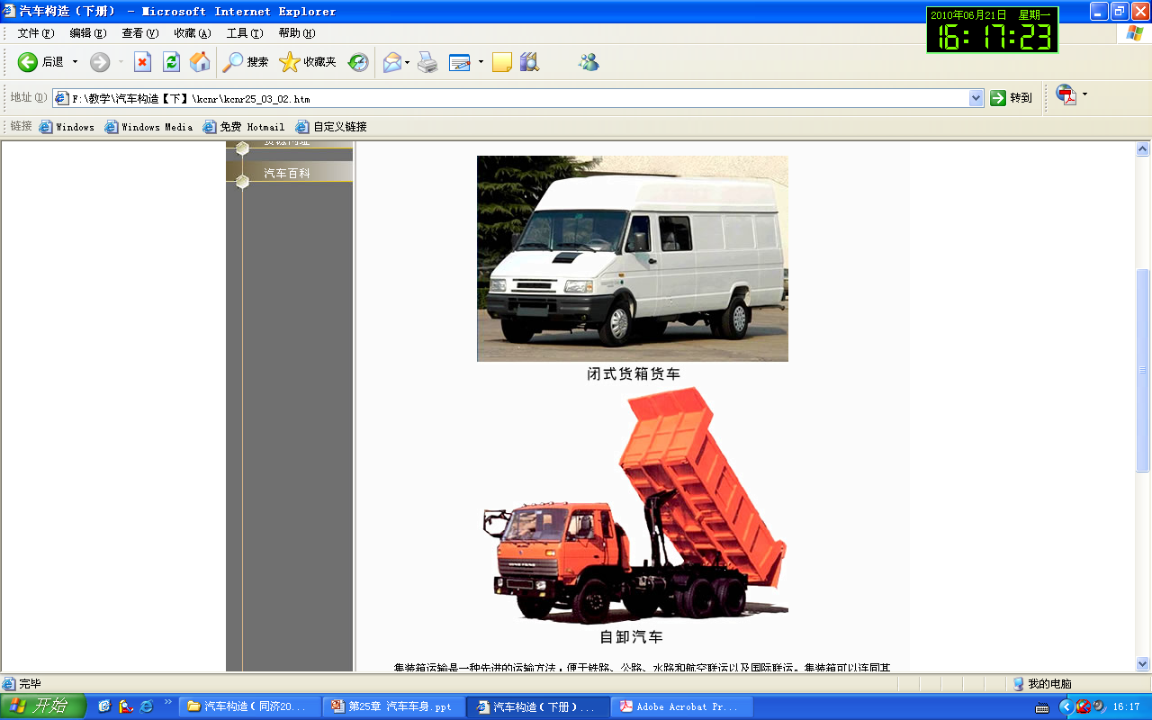
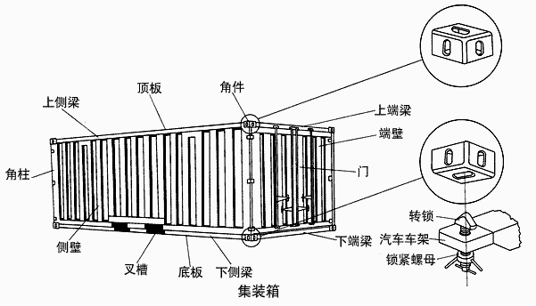
专用货箱
Special purpose cargo body

